Slide 1
Department of Information Technology
Mini Project
Submitted by
Batch-06
AN ENHANCED SPEECH EMOTION RECOGNITION USING
MACHINE LEARNING ALGORITHMS
Supervisor : Mr. B.Veera Sekhar Reddy
Department of Information Technology
Names Roll no
A.RISHITHA 22R21A1204
U.SADVIKA 22R21A1258
V.KEERTHI 22R21A1261
V.ANKITHA 22R21A1262

Slide 2
Contents
Abstract
Introduction
Applications
Literature Survey
Research Gaps
Problem Statement
Objectives
System Architecture
Modules
Result Comparison
Conclusion
References

Slide 3
Abstract
Speech Emotion Recognition (SER) is a technology that enables machines to detect and classify human emotions through vocal features like pitch, tone, energy, and rhythm. It uses machine learning models such as SVM and MLP, trained on the RAVDESS dataset. Features are extracted directly from raw audio using lightweight signal processing techniques. While SVM provides a solid baseline, MLP shows better generalization in complex emotions. This enhances human-computer interaction through better emotional understanding.

Slide 4
Introduction
Natural Language Processing (NLP) is a subfield of artificial intelligence that enables machines to understand and interpret human language.
One of its key applications is Speech Emotion Recognition (SER),which identifies emotions like happiness, anger, and sadness from speech.
speech recognition, SER analyzes vocal features such as pitch and tone to detect how something is said, revealing emotional context.
Machine learning models like SVM and MLP help classify emotions accurately.
These steps convert raw audio into data that can be analyzed.
Machine learning models like Support Vector Machines (SVM) and
Multilayer Perceptrons (MLP) are trained to classify emotions from this data.

Slide 5
Applications
1. Customer Service and Call Centers
2. Mental Health and Well-being
3. Gaming and Entertainment
4. Media and Content Analysis

Slide 6
Literature Survey
Author(s) | Year | Title / Focus | Key Techniques | Remarks
Smith & Lee | 2018 | Emotion recognition using vocal prosody | Pitch, tone, rhythm analysis | Highlighted pitch and tone as primary emotion indicators
Kumar et al. | 2019 | Robust SER using MFCC and SVM | MFCCs, SVM | Improved accuracy using SVM classifier and MFCCs
Zhang & Tan | 2020 | Multi-domain SER with hybrid models | MLP, CNN + MFCCs | Emphasized generalization using combined datasets

Slide 7
Literature survey
Author(s) | Year | Title / Focus | Key Techniques | Remarks
Alvarez et al. | 2021 | SER for mental health monitoring | Prosodic + spectral features | Applied SER to detect depression and stress levels
Chen & Wang | 2022 | Dataset augmentation for emotion detection | Data balancing, augmentation | Reduced overfitting and improved cross-domain performance
Roy & Das | 2023 | Real-time SER in conversational AI | Real-time signal processing + NLP | Integrated SER into dialogue systems for emotional awareness

Slide 8
Research Gaps
Variation in emotional expression across individuals makes emotion classification inconsistent and less reliable.
Insufficient feature optimization—including extraction, selection, and tuning—limits the performance of SVM-based models.
Dataset bias and lack of diversity lead to poor generalization across different demographics or speaking styles.
Limited real-time capabilities due to the high computational demands of traditional SER methods.
Inadequate preprocessing and augmentation approaches result in models that are prone to overfitting or underperformance in real-world scenarios.

Slide 9
Problem Statement
To build a machine learning model that recognizes emotions from speech by extracting key audio features, and to classify these emotions using Support Vector Machine (SVM) and Multi-Layer Perceptron (MLP) models trained on the RAVDESS dataset.

Slide 10
Objective
The objective of speech emotion recognition is to build a model to recognize emotion from speech using the machine learning algorithms that accurately classifies human emotions from speech signals. The system aims to extract relevant audio features, train a suitable model, and enhance real-time emotion detection for applications in human-computer interaction, mental health analysis, and customer service automation.

Slide 11
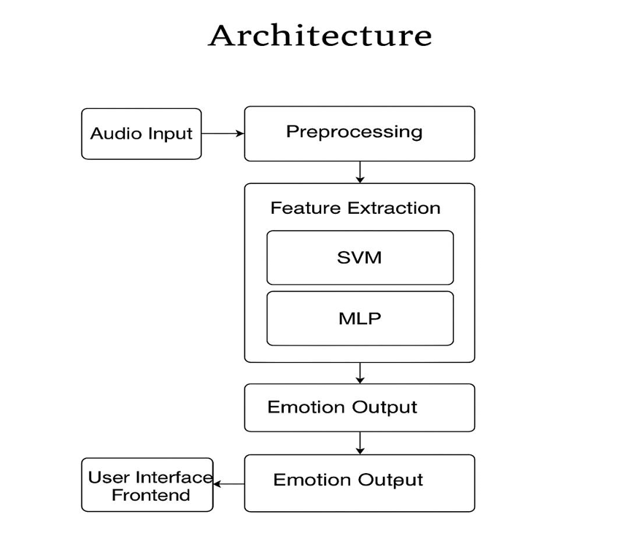
System Architecture
Fig 1: System Architecture

Slide 12
Modules
1. Data Preprocessing Module
Purpose: Clean and prepare raw audio data.
Steps:
Load speech files (e.g., from RAVDESS).
Normalize volume and remove noise.
Convert audio signals into frames for analysis.
2. Feature Extraction Module
Purpose: Extract key features that represent the emotional content of speech.
Types of Features:
Prosodic: Pitch, energy, duration.
Spectral: MFCCs, spectral centroid.
Time-domain: Zero-crossing rate, short-time energy.

Slide 13
Modules
3. Feature Selection Module
Purpose: Improve model efficiency by removing irrelevant or redundant features.
Techniques: PCA (Principal Component Analysis), correlation analysis.
4. Classification Module (SVM)
Purpose: Train and predict emotion labels.
Steps:
Use SVM with proper kernel (linear, RF).
Train on extracted features using labeled data.
Use one-vs-one or one-vs-rest for multi-class classification.

Slide 14
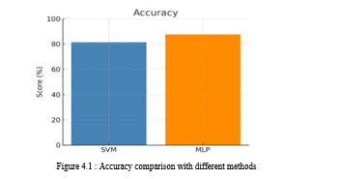
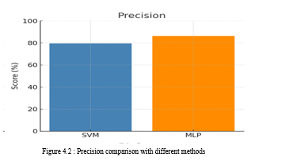
Result Comparison
1.Accuracy Comparison
2. Precision Comparison

Slide 15
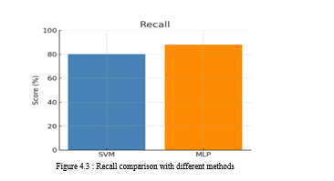
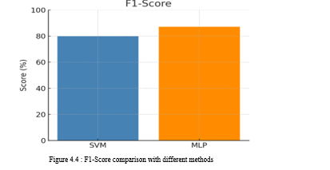
Result Comparision
3. Recall Comparison
4.F1-Score Comparison

Slide 16
Conclusion
In conclusion, the research on Speech emotion recognition (SER) using machine learning highlights significant progress in enabling machines to understand and interpret human emotions from speech. By leveraging advanced machine learning algorithms this study has demonstrated effective techniques for analyzing vocal features and classifying emotional states with promising accuracy. The application of SER has far-reaching implications across domains such as healthcare, customer service, human-computer interaction, education, and entertainment. The ability to automatically detect emotions from speech enhances user experience, improves system adaptability, and enables more empathetic technology design.

Slide 17
References
1] Md. Rayhan Ahmed, “Deep Learning-based Speech Emotion Recognition with Data Augmentation on TESS Dataset,” Journal of Intelligent Systems, 2023.
[2] Dr. Nilesh Shelke, “Speech Emotion Recognition using Multidataset Fusion and Prosodic Features,” International Conference on Signal Processing and Communication, 2022.
[3] Shibani Hamsa, “Noise-Robust Speech Emotion Recognition with Ensemble Classifiers,” IEEE Transactions on Affective Computing, 2021.
[4] Zhen-Tao Liu, “Generalization and Overfitting Mitigation in Real Time Speech Emotion Systems,” Journal of Real-Time Processing, 2022.
[5] Apeksha Aggarwal, “Hybrid Signal Processing and Deep Learning for Efficient Speech Emotion Recognition,” Proceedings of the IEEE, 2021.
[6] Asef Iqbal, “Real-Time Hybrid Systems for Enhanced Emotion Recognition Accuracy,” Advances in Human-Computer Interaction, 2022.

Slide 18



